Slide 1
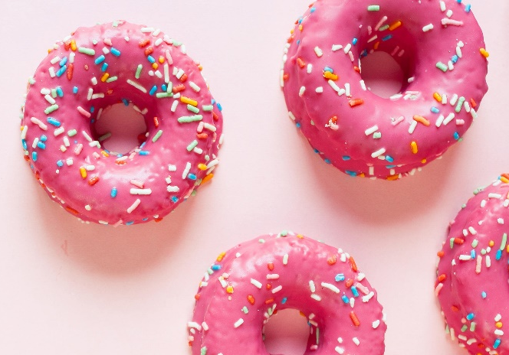
Home
Search…
Home
About Us
Menu
Contact Us

Slide 2
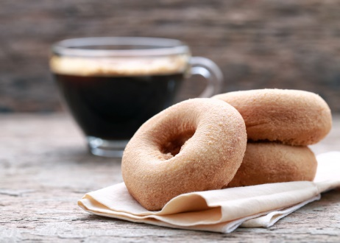




About Us
Donut Delights Story
Donut Delights was started in 1971 by Melvin Furballski.
In 1970 he landed in New York City and by chance he found an open seat on a bus heading west. When an unexpected mechanical failure forced a three day delay in Champaign, Illinois, Furballski decided to stay and with only one hundred dollars to his name, he transformed an abandoned bread shop into C-U’s finest breakfast and coffee shop!
Home Story Menu Contact
Notes:
http://www.freepik.com/free-icons

Slide 3
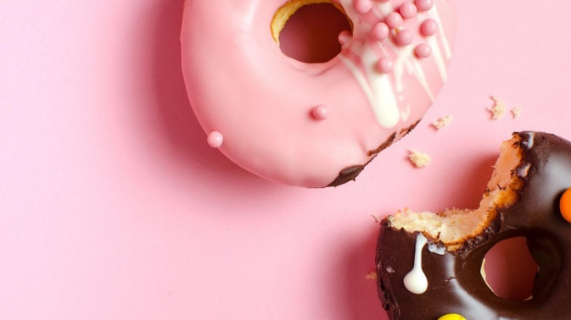
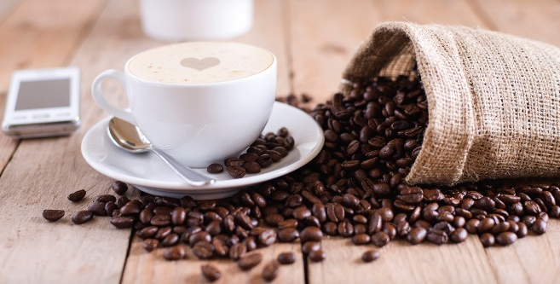
Menu
Donut: chocolate frosted, vanilla frosted, boston cream, jelly filled, cream filled, glazed, chocolate glazed, marble twist, sugar raised, plain donut, plain cruller, honey wheat, jelly puff, cream puff, coffee roll
Home Story Menu Contact
Notes:
http://www.freepik.com/free-icons

Slide 4
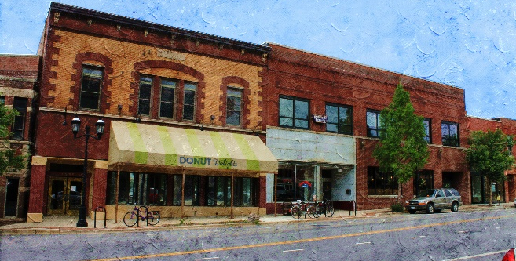
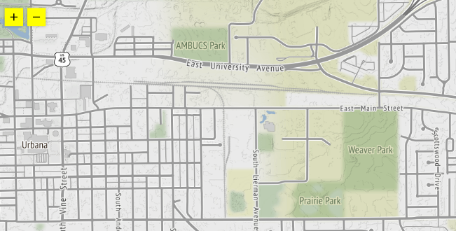
Contact Us
Subscribe to our newsletter for our
seasonal offerings & special events:
Email
Comments
2112 main street Urbana
Illinois 61801
Home Story Menu Contact
Notes:
http://www.freepik.com/free-icons

